Slide 1
Wine Data Set
Κελεπίρη Ζωή (78)
Βασιλόγαμβρος Ευάγγελος (100)

Slide 2
Wine Data Set
Article Study and Presentation
Six “W” questions for learning analytics
Constructs & measurement model
Predictive modelling
Data Analysis
Descriptive statistics
Machine Learning Models

Slide 3

Purpose of Research
This research aims to predict wine quality using synthetic data and experimental data from New Zealand's diverse regions. 18 Pinot noir wine samples with 54 characteristics were used, with 1381 samples generated using the SMOTE method. Six samples were retained for model testing. The quality of New Zealand Pinot noir wines is crucial in wineries worldwide.

Slide 4
Purpose of Research
The study compared four feature selection approaches for predicting wine quality using key variables. Seven machine learning algorithms were trained, with AdaBoost showing 100% accuracy without feature selection and Random Forest showing increased performance with key variables.

Slide 5
Six W Questions
What we are measuring?
Wine quality Pinot noir from New Zealand. 18 samples(7 were physicochemical and 47 chemical characteristics)
How we are measuring?
Synthetic data using the SMOTE method (Synthetic Minority Over-sampling Technique). Synthetic data were generated from 12 original samples.

Slide 6
Six W Questions
Why is knowledge important to us?
Wine quality is an important issue in the wine industry. This research aims to predict the quality of Pinot noir by selecting the most suitable characteristics using machine learning, based on synthetic data and experimental data from different regions of New Zealand.
Who is the analytic for?
The analysis is aimed at those interested in the wine industry, in particular those who want to predict the quality of Pinot noir using machine learning. The article also mentions that there are experts who worked on predicting the quality of wine.

Slide 7
Six W Questions
Where does the data collection happen?
Experimental data is collected from various and varied regions throughout New Zealand that produce Pinot noir wine.
When does the data collection & feedback occur?
No specific information is provided about when the data is collected or the feedback is given.

Slide 8
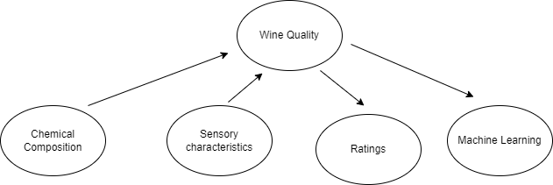
Measurement Model
Constructs
Wine quality
Latent variable
The key latent variable on this scenario is the wine quality.
The indicators? (text and graphics)
Chemical makeup (casual)
Sensory qualities (casual)
Opinions of experts (effect)
Machine Learning Models (effect)

Slide 9
Measurement Model - Constructs Type
Chemical composition both continuous and discrete according (the flavor,4-ethyl-2-methoxyphenol)
Sensory characteristics (softness, black glass)
Assessments from experts are continuous
Machine learning models results are continuous
The wine quality is continuous (rating from low to high)

Slide 10
Measurement Model - Instruments
Chemical Composition: Chromotographty, ph – meter, spectrophotometry
Reliability → calibration, precision testing, and consistency
Validity → accuracy of these instruments in measuring specific components.
Sensory Evaluations: Experts assessments with specific techniques
Reliability → rigorous training, calibration, and consistency checks
Validity →sensory descriptors, reference standards, and statistical analyses.
Experts evaluation: use rating scales or scoring sheets
Reliability → training and calibration exercises
Validity →sensory and chemical analyses.
Machine Learning: SVM, RF, and AdaBoost predict wine quality based on input features
Reliability → accuracy, precision, recall, and F1 score
Validity →involves models accurately reflecting data patterns

Slide 11
Measurement Model – Math Model
Math Model: xij​=λij​η+εij + a
xij​: indicator
λij: factor loading coefficient
εij: random error
a intercept
η: latent variable
* (i equals to number of constructs, j the value of each construct)

Slide 12
Predictive Model
Predictive modeling is a commonly used statistical technique to predict future behavior.
Classification is a process related to categorization, the process in which ideas and objects are recognized, differentiated and understood.
Classification is the grouping of related facts into classes. It may also refer to a process which brings together like things and separates unlike things.

Slide 13
Accuracy
83%
33%
100%
83%
83%
83%
RF
GNB
AdaBoost
SGD
SVM
KNN

Slide 14
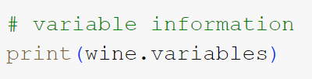
Ανάλυση Δεδομένων στο wine data set
Τύποι δεδομένων
name role type demographic
0 class Target Categorical None
1 Alcohol Feature Continuous None
2 Malicacid Feature Continuous None
3 Ash Feature Continuous None
4 Alcalinity_of_ash Feature Continuous None
5 Magnesium Feature Integer None
6 Total_phenols Feature Continuous None
7 Flavanoids Feature Continuous None
8 Nonflavanoid_phenols Feature Continuous None
9 Proanthocyanins Feature Continuous None
10 Color_intensity Feature Continuous None
11 Hue Feature Continuous None
12 0D280_0D315_of_diluted_wines Feature Continuous None
13 Proline Feature Integer None

Slide 15

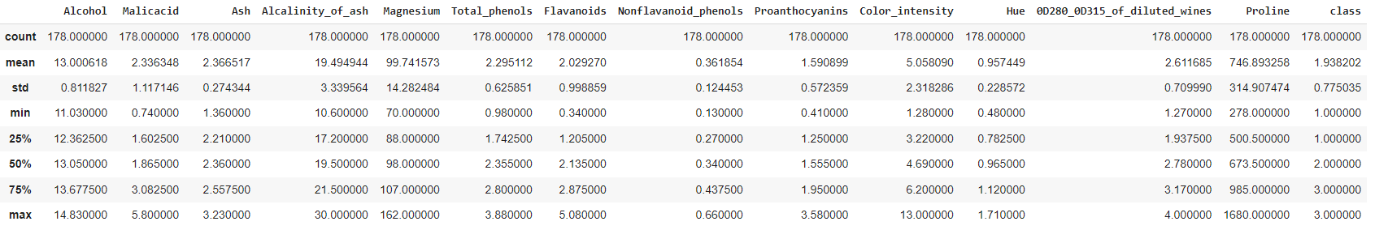
Ανάλυση Δεδομένων στο wine data set
Describe

Slide 16
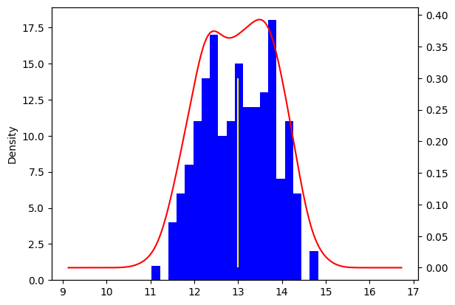
Ανάλυση Δεδομένων στο wine data set
Describe

Slide 17
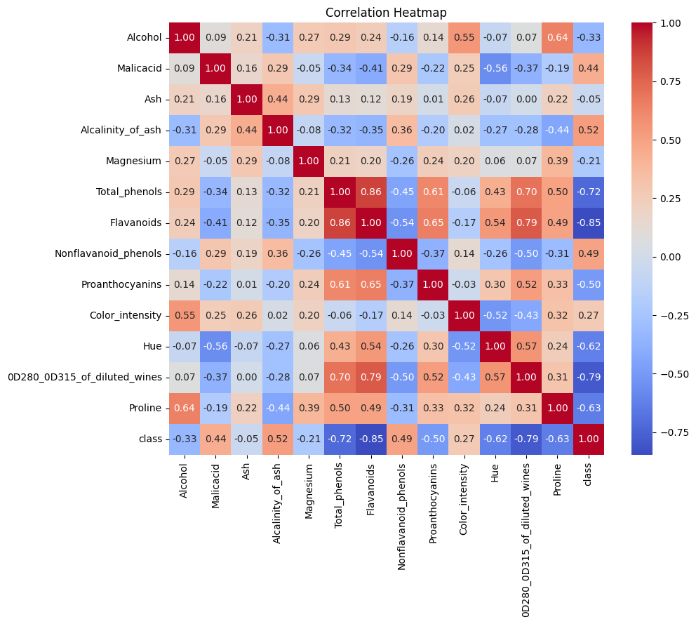
Ανάλυση Δεδομένων στο wine data set
Correlation Analysis

Slide 18
Data Charts Infographics
Venus
Mars
Saturn
90%
75%
60%
70%
40%
85%
80%
100%
60%
2020
2021
2022
Venus is the second planet from Sun
Mars is a cold place full of iron oxide dust
Saturn is a gas giant and has several rings

Slide 19
Algorithms | Df | Df ( cor > 0.7) | Df (cor > 0.5)
Logistic Regression | 0.9778 | 0.9778 | 0.890
Random Forest | 1.00 | 1.00 | 0.933
KNN | 0.94 | 0.97 | 0.89
Decision Trees | 0.916 | 0.972 | 0.888
Gradient Boosting | 1.00 | 1.00 | 0.972
AdaBoost | 0.944 | 0.972 | 0.972

Slide 20
Data Charts Infographics
Venus
Mars
Saturn
90%
75%
60%
70%
40%
85%
80%
100%
60%
2020
2021
2022
Venus is the second planet from Sun
Mars is a cold place full of iron oxide dust
Saturn is a gas giant and has several rings

Slide 21
Data Charts Infographics
1000
900
Product 1
800
Venus is the second planet from the Sun
700
600
500
400
Product 2
300
Saturn is composed of hydrogen and helium
200
100
2020
2021
2022
2023
2024

Slide 22
Data Charts Infographics
Saturn
Venus
Jupiter
+90
Venus has a nice name and is the second planet from the Sun
Mars
+80
Earth
+70
Venus
+60
Saturn
+50
Saturn is the ringed planet, composed of hydrogen and helium
Mars
Despite being red, Mars is a cold planet full of iron oxide dust

Slide 23
Data Charts Infographics
80%
90%
10%
60%
70%
50%
2020
2021
2022
2023
2024
2025

Slide 24
Data Charts Infographics
150€
100€
100€
70€
Quarter 1
Quarter 2
Quarter 3
Quarter 4
Venus has a nice name
Mars is a cold place
Jupiter is the biggest planet
Saturn has several rings

Slide 25
Data Charts Infographics
Mercury is the smallest planet
Mercury
100%
Venus has a beautiful name
Venus
50%
Earth
60%
Earth in the only planet with life
Mars is actually a cold place
Mars
30%
Saturn is a gas giant and has rings
Saturn
80%

Slide 26
Data Charts Infographics
Mars
60%
Despite being red, Mars is actually a cold place full of iron oxide dust
Venus
80%
Venus has a beautiful name, but it’s terribly hot, even hotter than Mercury
Neptune
50%
Neptune is the fourth-largest planet by diameter in the Solar System

Slide 27
Data Charts Infographics
100%
60%
90%
80%
Venus
Mars
Mercury
Saturn
Venus has a beautiful name
Mars is actually a cold place
Mercury is the smallest planet
Saturn is a gas giant and has rings

Slide 28
Data Charts Infographics
Product 1
Product 2
Venus has a beautiful name and is the second planet from the Sun
Despite being red, Mars is a cold place full of iron oxide dust
Product 3
Product 4
Mercury is the closest planet to the Sun and the smallest one
Jupiter is a gas giant and the biggest planet in the Solar System

Slide 29
Data Charts Infographics
75%
50%
30%
80%
Saturn
Mercury
Mars
Jupiter
It’s composed of hydrogen and helium
Mercury is the closest planet to the Sun
Despite being red, Mars is a cold place
Jupiter is a gas giant and the biggest planet

Slide 30
Data Charts Infographics
Quarter 1
Quarter 2
15%
Venus has a beautiful name and is the second planet from the Sun
Despite being red, Mars is a cold place full of iron oxide dust
15%
25%
Quarter 3
Quarter 4
35%
Mercury is the closest planet to the Sun and the smallest one
Jupiter is a gas giant and the biggest planet in the Solar System

Slide 31
Data Charts Infographics
Venus
50%
Mars
Venus has a beautiful name and is the second planet from the Sun
Despite being red, Mars is a cold place full of iron oxide dust
35%
10%
Mercury
Jupiter
Mercury is the closest planet to the Sun and the smallest one
15%
Jupiter is a gas giant and the biggest planet in the Solar System

Slide 32
Data Charts Infographics
Venus
75%
Venus has a beautiful name and is the second planet from the Sun
65%
50%
Jupiter
Jupiter is a gas giant and the biggest planet in the Solar System
Mercury
Mercury is the closest planet to the Sun and the smallest of them all

Slide 33
Data Charts Infographics
50%
60%
Venus
Mars
Venus has a beautiful name and is the second planet from the Sun
Despite being red, Mars is a cold place full of iron oxide dust
70%
80%
Mercury
Jupiter
Mercury is the closest planet to the Sun and the smallest one
Jupiter is a gas giant and the biggest planet in the Solar System

Slide 34
Data Charts Infographics
Venus
Venus has a beautiful name and is the second planet from the Sun
80%
Jupiter
Jupiter is a gas giant and the biggest planet in the Solar System
70%
Mercury
55%
Mercury is the closest planet to the Sun and the smallest of them all

Slide 35
Data Charts Infographics
Venus
Mars
Venus has a beautiful name and is the second planet from the Sun
Despite being red, Mars is a cold place full of iron oxide dust
Mercury
Jupiter
Mercury is the closest planet to the Sun and the smallest one
Jupiter is a gas giant and the biggest planet in the Solar System

Slide 36
Data Charts Infographics
Mercury
5/10
Mercury is the closest to the Sun
Venus
8/10
Venus is the second planet from the Sun
Earth
4/10
Planet Earth is the only one with life
Mars
7/10
Mars is a cold place full of iron oxide dust

Slide 37
Data Charts Infographics
January
Project 1
Project 2
February
Project 3
March
Project 4
April
May
Planet Venus
Venus has a beautiful name and is the second planet from the Sun. It is terribly hot, even hotter than Mercury
June
0
10
15
20
25
30

Slide 38
Data Charts Infographics
71+
70
60
50
40
30
20
100%
75%
50%
25%
0%
25%
50%
75%
100%
Male
Female

Slide 39
Data Charts Infographics
Mercury
Venus
Earth
Mars
Jupiter
Saturn
JAN
FEB
MAR
APR
MAY
JUN
JUL
AUG
SEP
OCT
NOV
DEC

Slide 40
Data Charts Infographics
Venus
Venus has a beautiful name and is the second planet from the Sun
9,000
Mercury
Mercury is the closest planet to the Sun and the smallest one
5,000
Mars
Despite being red, Mars is a cold place full of iron oxide dust
4,000
Jupiter
Jupiter is a gas giant and the biggest planet in the Solar System
8,000

Slide 41
Data Charts Infographics
400
400
200
Mercury
Q4
Mercury is the smallest planet
600
100
300
Q3
Venus
200
300
500
Venus is the second planet from the Sun
Q2
300
500
200
Q1
Earth
Earth is the only planet with life
100
300
500
700
900

Slide 42
Data Charts Infographics
+50
Losses
+40
+30
Mercury is the closest planet to the Sun and the smallest one
+20
+10
Profits
-10
-20
Venus has a beautiful name and is the second planet from the Sun
-30
-40
-50

Slide 43
Data Charts Infographics
1000
200
1000
900
800
400
700
600
500
400
100
300
300
200
100
0
Venus
Mars
Jupiter
Saturn
Earth
Venus has a beautiful name
Mars is a cold place
Jupiter is the biggest planet
Saturn has several rings
Earth is the planet with life

Slide 44
Data Charts Infographics
Product 1
Product 2
1000
900
800
700
600
500
400
300
200
100
Jan
Feb
Mar
Apr
May
Jun
Jul
Aug
Sep
Oct
Nov
Dec

Slide 45
Data Charts Infographics
Result 1
500
Venus is the second planet from the Sun
400
Result 2
300
Saturn is composed of hydrogen and helium
200
Result 3
100
Mars is a cold planet full of iron oxide dust
Item 1
Item 2
Item 3
Item 4

Slide 46
Data Charts Infographics
Jan
Feb
Mar
Apr
May
Jun
Jul
Aug
Sep
Oct
Nov
Dec
Product 1
Product 2

Slide 47
Data Charts Infographics
50M
Product 1
Venus is the second planet from the Sun
40M
30M
Product 2
Saturn is composed of hydrogen and helium
20M
10M
Product 3
Mars is a cold planet full of iron oxide dust
Q1
Q2
Q3
Q4

Slide 48
Data Charts Infographics
100
50
60
70
90
40
Mercury
Venus
Earth
Mars
Jupiter
Saturn

Slide 49
Data Charts Infographics
$5000
$4000
$3000
$2000
$1000
Item 1
Item 2
Item 3
Item 4
Item 5

Slide 50
Instructions for use (free users)
In order to use this template, you must credit Slidesgo by keeping the Thanks slide.
You are allowed to:
Modify this template.
Use it for both personal and commercial purposes.
You are not allowed to:
Sublicense, sell or rent any of Slidesgo Content (or a modified version of Slidesgo Content).
Distribute this Slidesgo Template (or a modified version of this Slidesgo Template) or include it in a database or in any other product or service that offers downloadable images, icons or presentations that may be subject to distribution or resale.
Use any of the elements that are part of this Slidesgo Template in an isolated and separated way from this Template.
Delete the “Thanks” or “Credits” slide.
Register any of the elements that are part of this template as a trademark or logo, or register it as a work in an intellectual property registry or similar.
For more information about editing slides, please read our FAQs or visit Slidesgo School:
https://slidesgo.com/faqs and https://slidesgo.com/slidesgo-school

Slide 51
Instructions for use (premium users)
In order to use this template, you must be a Premium user on Slidesgo.
You are allowed to:
Modify this template.
Use it for both personal and commercial purposes.
Hide or delete the “Thanks” slide and the mention to Slidesgo in the credits.
Share this template in an editable format with people who are not part of your team.
You are not allowed to:
Sublicense, sell or rent this Slidesgo Template (or a modified version of this Slidesgo Template).
Distribute this Slidesgo Template (or a modified version of this Slidesgo Template) or include it in a database or in any other product or service that offers downloadable images, icons or presentations that may be subject to distribution or resale.
Use any of the elements that are part of this Slidesgo Template in an isolated and separated way from this Template.
Register any of the elements that are part of this template as a trademark or logo, or register it as a work in an intellectual property registry or similar.
For more information about editing slides, please read our FAQs or visit Slidesgo School:
https://slidesgo.com/faqs and https://slidesgo.com/slidesgo-school

Slide 52
Infographics
You can add and edit some infographics to your presentation to present your data in a visual way.
Choose your favourite infographic and insert it in your presentation using Ctrl C + Ctrl V or Cmd C + Cmd V in Mac.
Select one of the parts and ungroup it by right-clicking and choosing “Ungroup”.
Change the color by clicking on the paint bucket.
Then resize the element by clicking and dragging one of the square-shaped points of its bounding box (the cursor should look like a double-headed arrow). Remember to hold Shift while dragging to keep the proportions.
Group the elements again by selecting them, right-clicking and choosing “Group”.
Repeat the steps above with the other parts and when you’re done editing, copy the end result and paste it into your presentation.
Remember to choose the “Keep source formatting” option so that it keeps the design. For more info, please visit Slidesgo School.

